Slide 1

BITE_BLISS
DEVELOPED BY-
1.KRISHNA SHARMA
2.MUDITA CHATURVEDI

Slide 2

ABOUT OUR WEBSITE
HEY FOLKS!!
WELCOME TO BITE_BLISS, WHERE EVERY MEAL IS A CHANCE TO CREATE SOMETHING DELICIOUS! WHETHER YOU ARE A SEASONED CHEF OR JUST STARTING YOUR CULINARY JOURNEY, WE HAVE GOT THE PERFECT TOO INSPIRE YOUR NEXT KITCHEN ADVENTURE. LET’S MAKE COOKING FUN AND EFFORTLESS!!

Slide 3
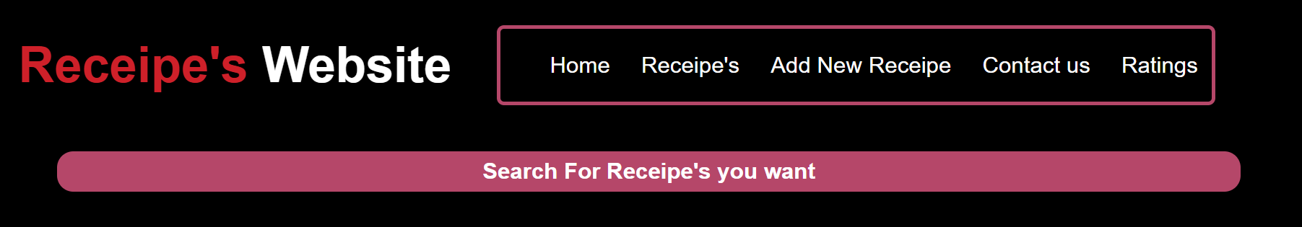
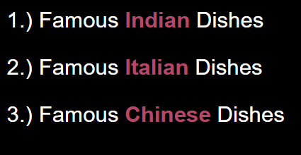
LAYOUT OF OUR WEBSITE
#OUR WEBSITE HAS A NAVIGATION BUTTON FOR USER’S CONVINIENCE WHICH WILL DIRECT THEM TO EXPLORE THE VARIOUS VARIETY OF RECIPES PRESENT IN OUR WEBSITE…
#FROM QUICK WEEKNIGHT ITALLIAN DINNERS TO GOURMENT INDIAN FEAST – THE WEBSITE OFFERS INDIAN, CHINEESE AND ITALLIAN DISHES.

Slide 4
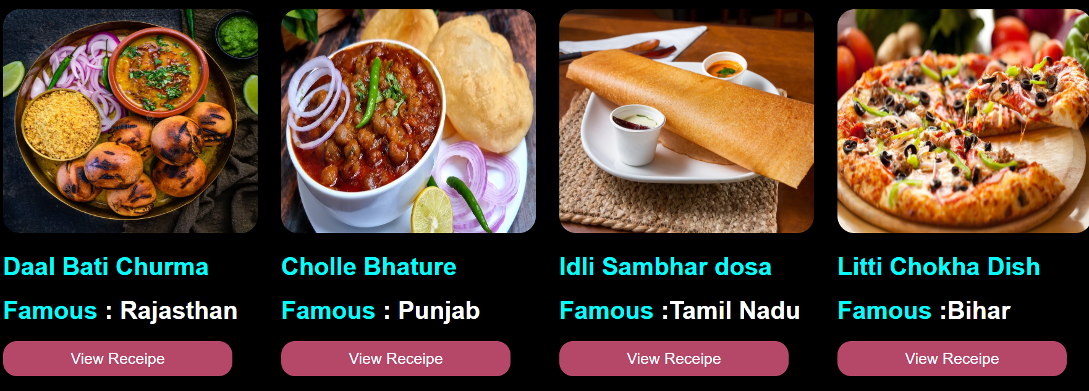
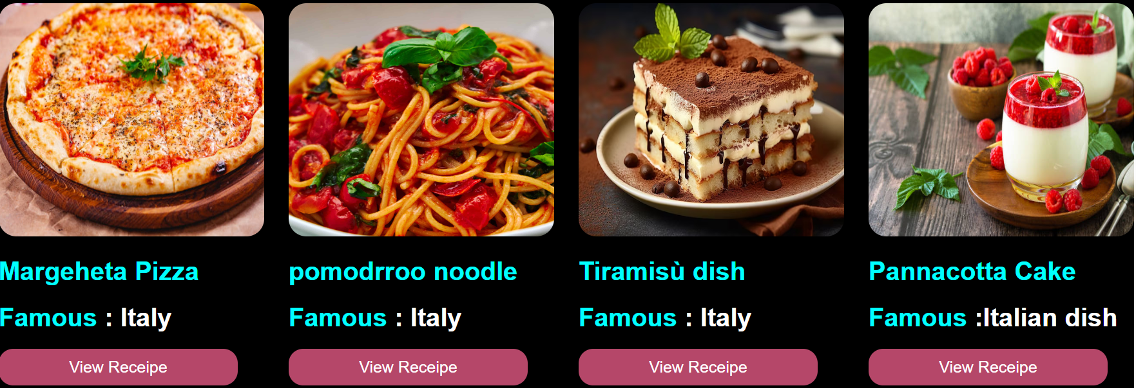
# THE INDIAN DISHES
This section delivers the best Indian food options along with their recipe which pops up when the user clicks on the “VIEW RECIPE” button.
#THE ITALIAN DISHES
This section delivers the best Indian food options along with their recipe which pops up when the user clicks on the “VIEW RECIPE” button.

Slide 5
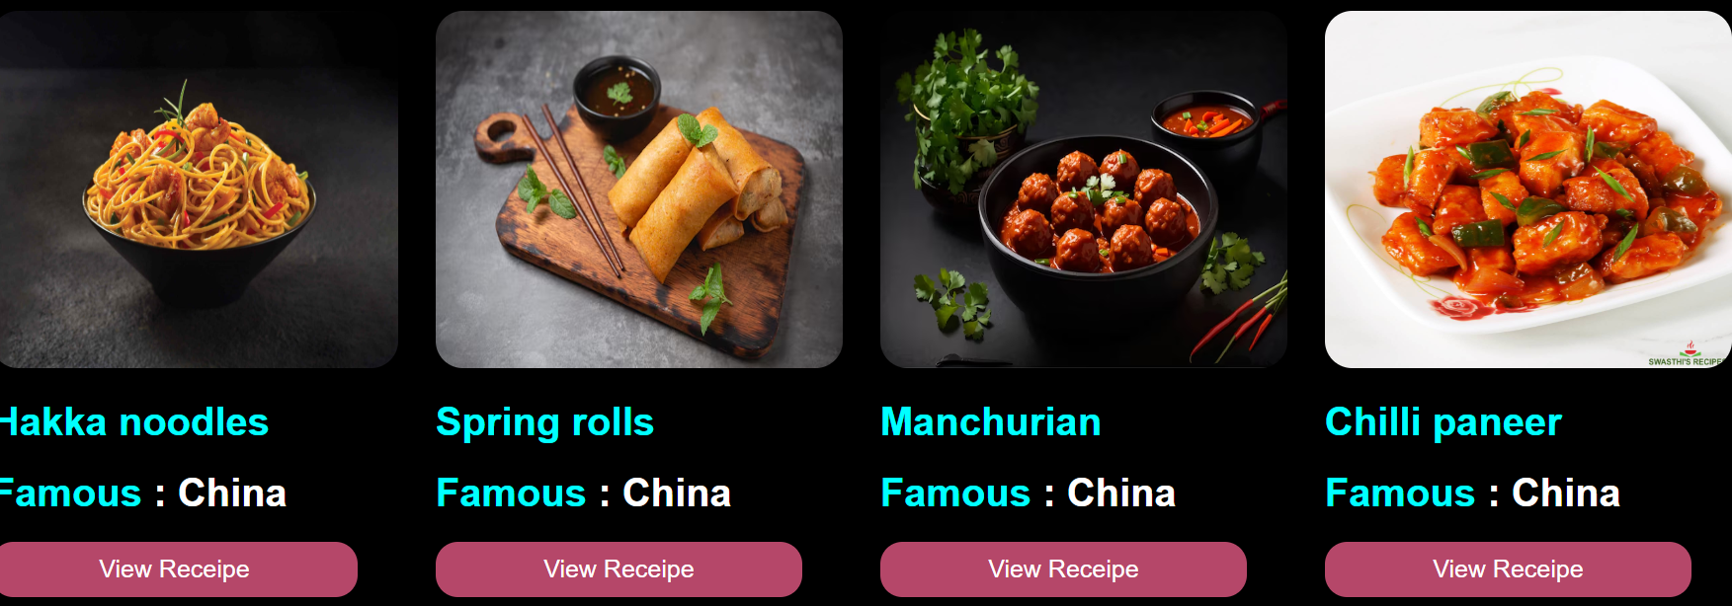
#THE CHINESE DISHES
This section delivers the best Indian food options along with their recipe which pops up when the user clicks on the “VIEW RECIPE” button.

Slide 6
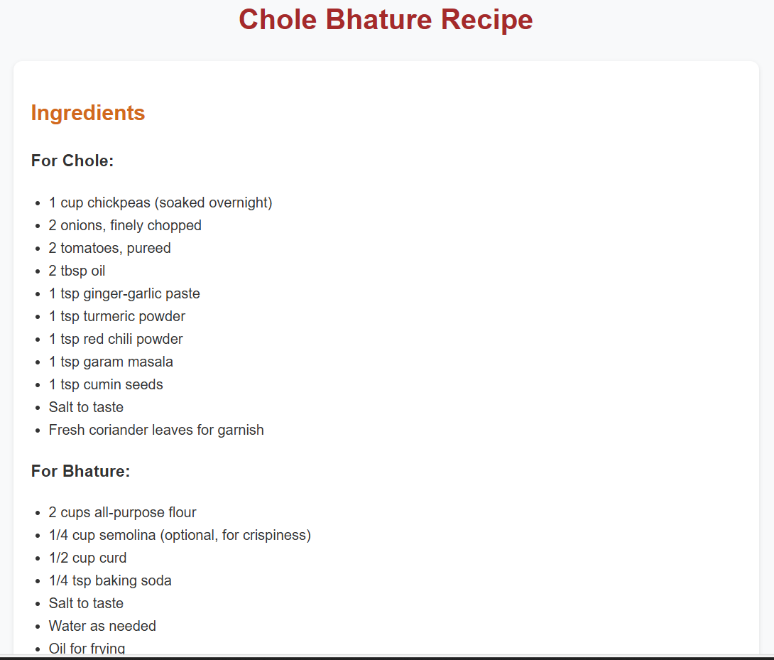
#UPON CLICKING THE “VIEW RECIPE” BUTTON, THE SITE WILL DIRECT THE USER TO A NEW WEBPAGE SHOWING THE ENTIRE RECIPE OF THE CHOOSEN DISH…A SAMPLE OF THE CHOOSEN DISH IS SHOWN IN THE ATTACHED IMAGE

Slide 7
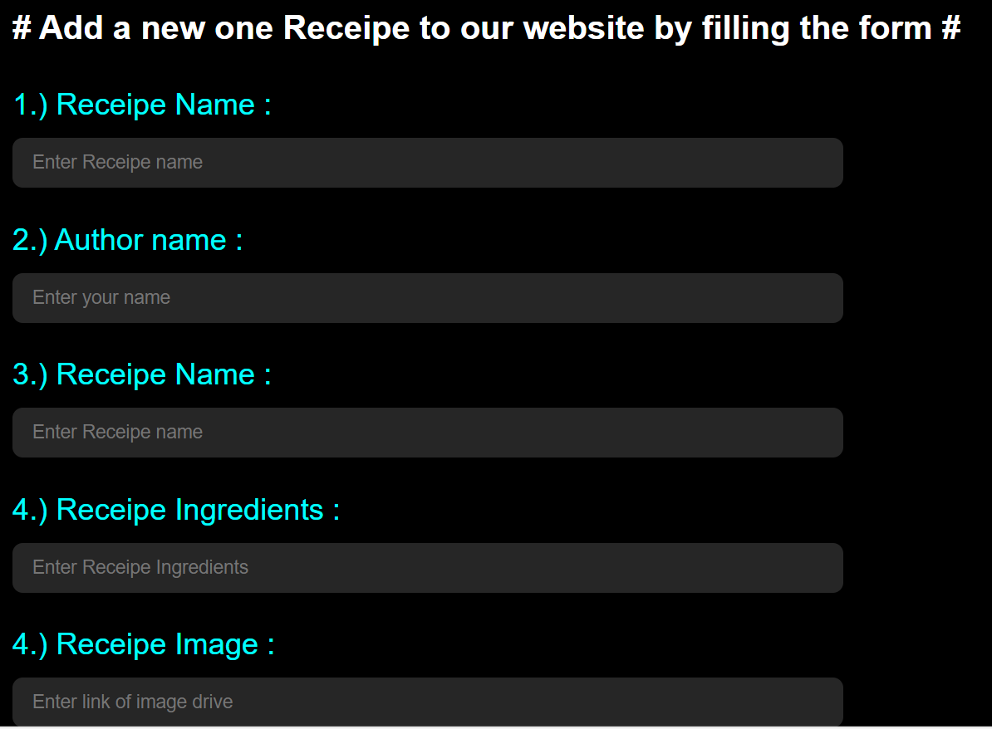
# Focusing on the community of passionate home cooks….we have added a page where user can share their own recipe by filling a form which include- his/her name, dish name, dish category, recipe image and preparation type..

Slide 8
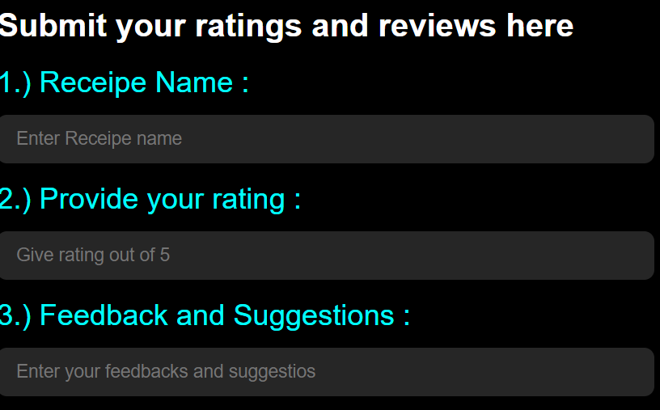
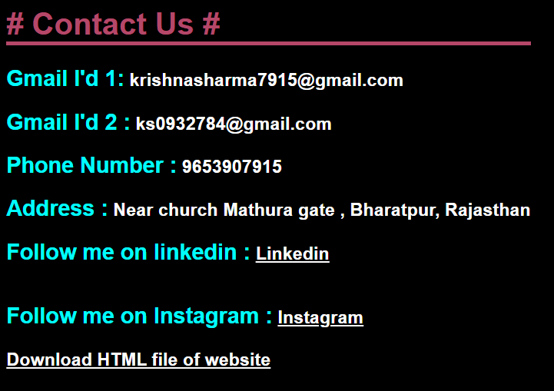
#User’s suggestions and feedbacks are the most crucial part of our website. Therefore we have added a rating system to categorise our recipe based on user’s opinion…
#For contacting the developers in case of any inconvenience-the email id as well as the mobile no are provided…

Slide 9
HTML TAGS USED IN THE WEBSITE
FOLLOWING ARE THE LIST OF TAGS USED IN HTML PART OF BACKEND-
<head>
It is a container for metadata and is placed between <HTML> and <BODY> tag.
<title>
It defines the title of the document.
<meta>
It defines meta-data about HTML document.
<link>
Defines the relationship between document and resources

Slide 10
13.<span>
Defines a section in a document.
14.<br>
Defines a single line break.
15.<button>
Defines a clickable button.
16.<img>
Defines an image.
17.<p>
Defines a paragraph.
18.<pre>
Defines preformatted text.
19.<form>
Defines a form for user input
20.<label>
Defines a label for an <input> element.
5.<body>
Defines the document’s body.
6.<div>
Defines a section in a document.
7.<header>
Defines a header for a document.
8.<nav>
Defines navigation links.
9.<li>
Defines a list item.
10.<ul>
Defines a unordered list.
11.<a>
Defines a hyperlink.
12.<input>
Defines a input control.

Slide 11
CSS TAGS USED IN THE WEBSITE
CSS (CASCADING STYLE SHEET) IS USED TO STYLE AND LAYOUT WEB PAGES. FOR EXAMPLE…TO ALTER THE FONT, COLOR SIZE AND SPACING OF YOUR CONTENT, SPLIT IT INTO MUTIPLE COLUMNS OR ADD ANIMATIONS AND OTHER DECORATIVE FEATURES.
1.TAGS
The class creates a rectangular tag.The default color is black.
Some example of tags- Colored tags, Letter tags, Rotating tags, Spinning tags.
2.SIGNS
Signs are nothing but larger tags.
Some example of signs-Road signs, Large signs, Rounded signs.

Slide 12
3.CSS- Fonts,Colors,Sizes
*CSS Color-family property defines the text color to be used.
*CSS Font-family property defines the font to be used.
*CSS Size-family property defines the text size to be used.
4.CSS-BORDER
The CSS-BORDER property defines a border around HTML element.
5.CSS-PADDING
The CSS-PADDING property defines a padding between the text and border

Slide 13
THANK YOU

